Slide 1
CASE STUDY
GAME ANALYTICS

Slide 2
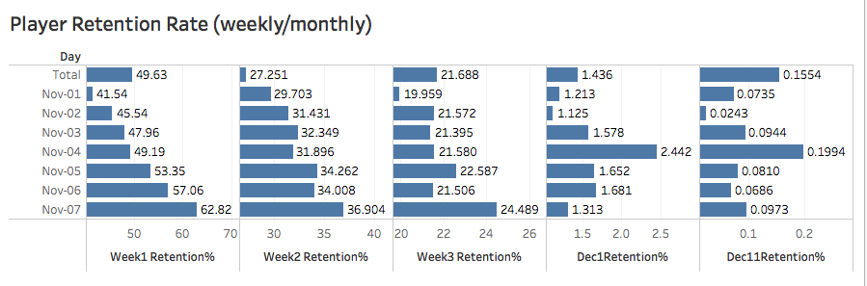
PLAYER RETENTION RATE
RETENTION RATE AFTER WEEK1/2/3, ON DEC1, DEC11 IN %

Slide 3

RFT ANALYSIS
RECENCY/FREQUENCY/TIME FOR PLAYERS- RFT

Slide 4
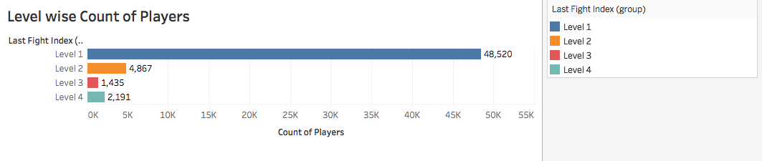
KEY INSIGHTS
PLAYERS AT DIFFERENT LEVELS- LEVEL1- HAVING LAST FIGHT INDEX-1-5
,LEVEL2- LAST FIGHT INDEX-6-10, LEVEL3-LAST FIGHT INDEX-11-15,
LEVEL4 -LAST FIGHT INDEX-16-20 I

Slide 5
Majority of players are on Level1, it could be because they are not interested in the game and hence do not play, or they find it too difficult. Other reasons could be technical issues they are facing

Slide 6
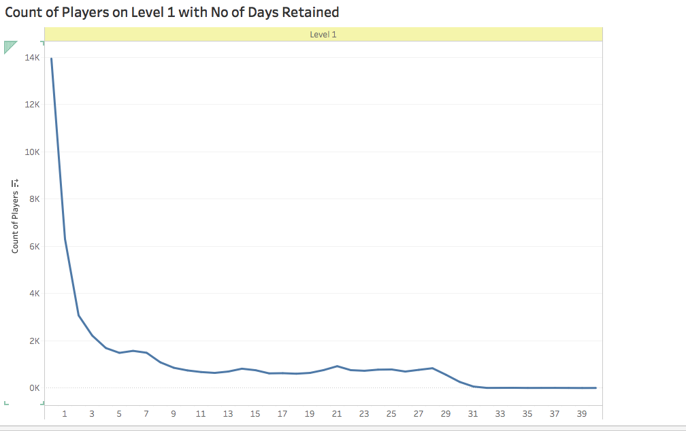

Slide 7
The Line Curve shows that majority of players who are on level 1 did not play game for more than 3 days, ie days_retain <=3, so the reason for being stuck on Level1 most probably was they found it boring and did not continue it or they faced some technical issues and thus could not play further, they might not have the required OS specifications for the game

Slide 8
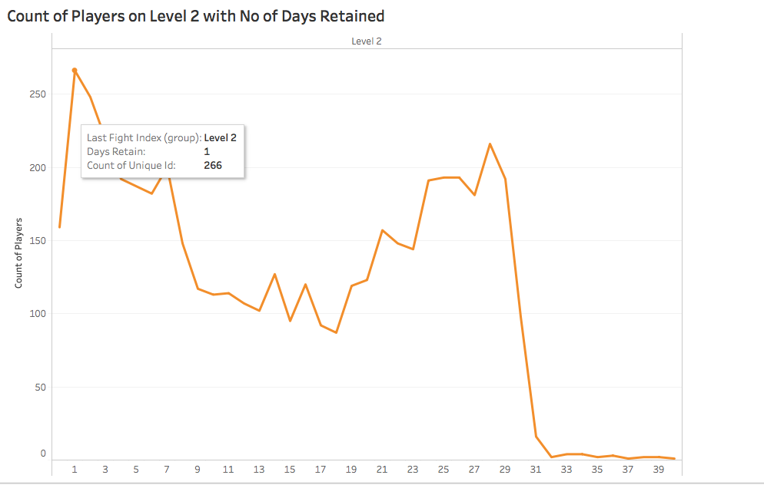
No OF PLAYERS ON LEVEL 2 WITH THEIR DAYS SPENT ON THE GAME

Slide 9
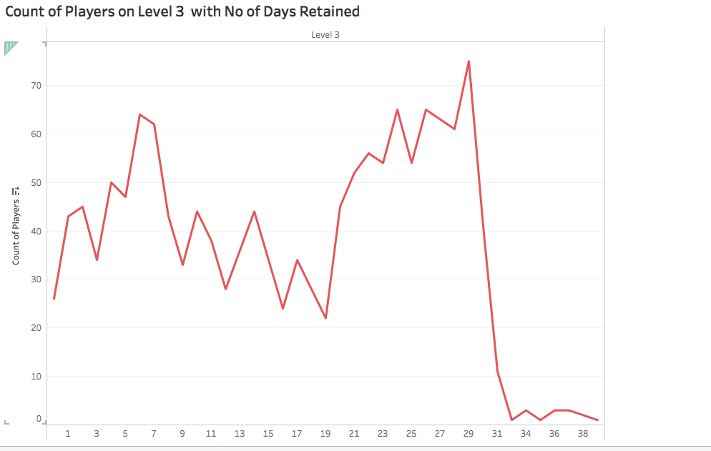
No OF PLAYERS ON LEVEL 3 WITH THEIR DAYS SPENT ON THE GAME

Slide 10
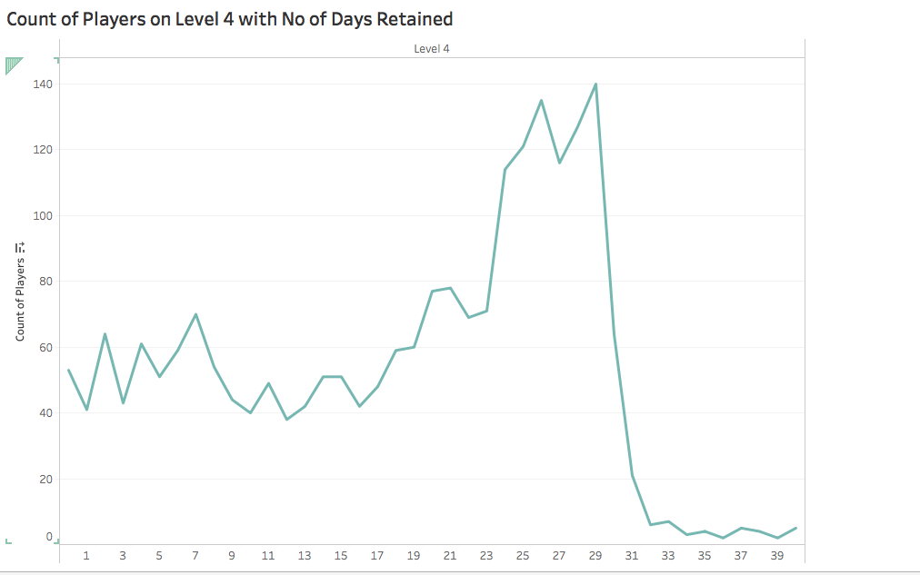
No OF PLAYERS ON LEVEL 4 WITH THEIR DAYS SPENT ON THE GAME

Slide 11
Most of the players on Level 3 and Level 4 are those who had spent 20-31 days on the game, these users tend to find the game exciting and thus continue playing

Slide 12
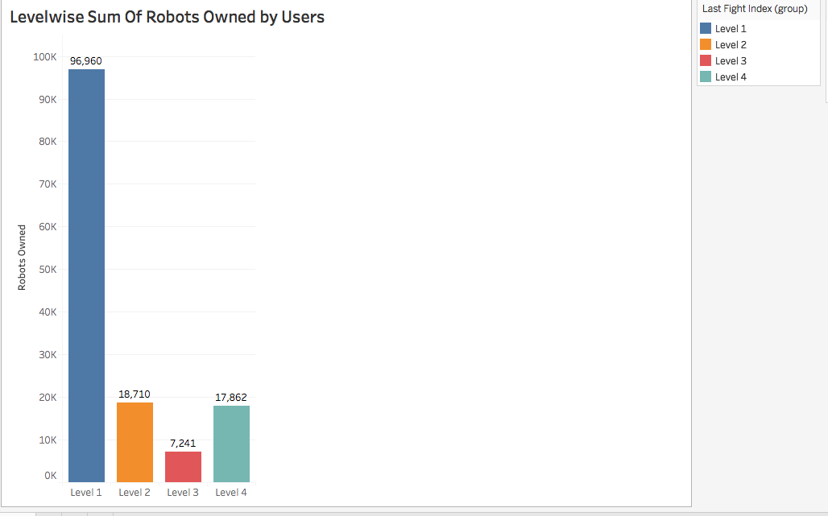
ROBOTS OWNED ARE MAX IN LEVEL1

Slide 13
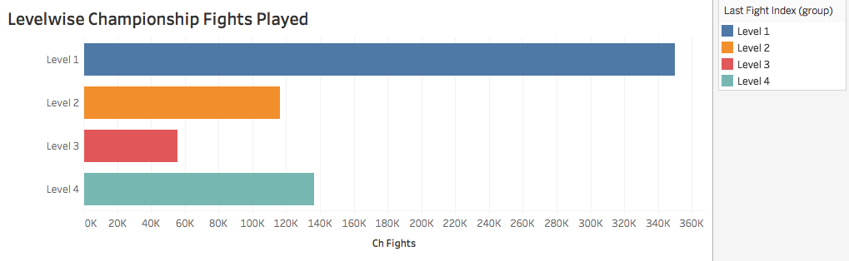
CHAMPIONSHIP FIGHTS PLAYED ARE MAXIMUM IN LEVEL1

Slide 14
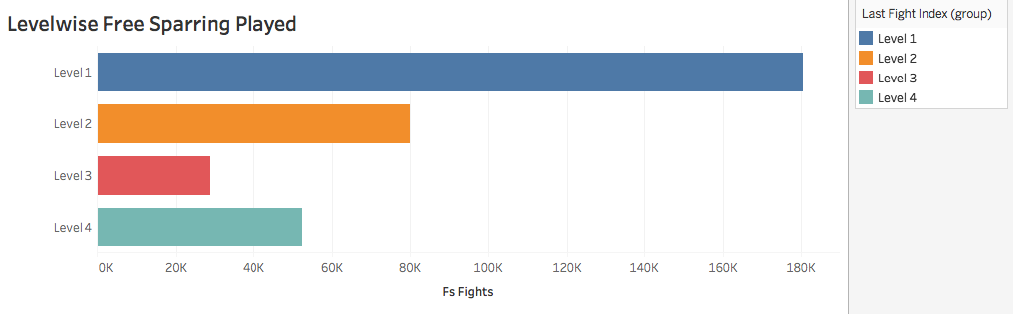
FREE SPARRING FIGHTS PLAYED ARE ALSO MAX IN LEVEL1

Slide 15
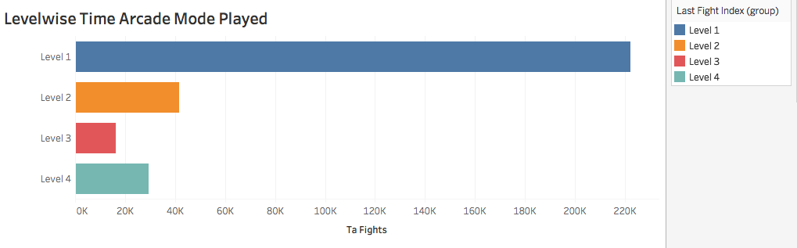
ARCADE MODE FIGHTS PLAYED ARE ALSO MAX IN LEVEL 1

Slide 16
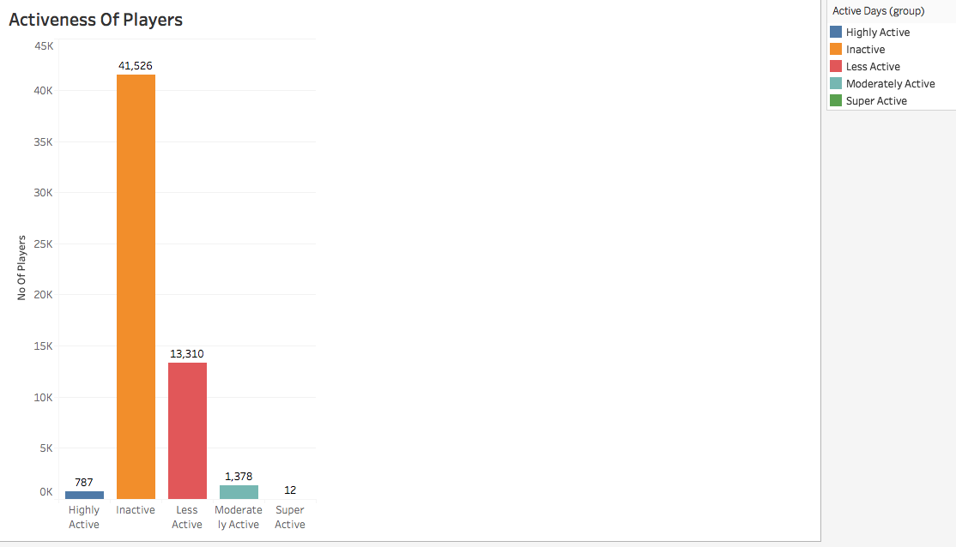
ACTIVENESS OF PLAYERS DEPENDING ON NO OF ACTIVE DAYS

Slide 17
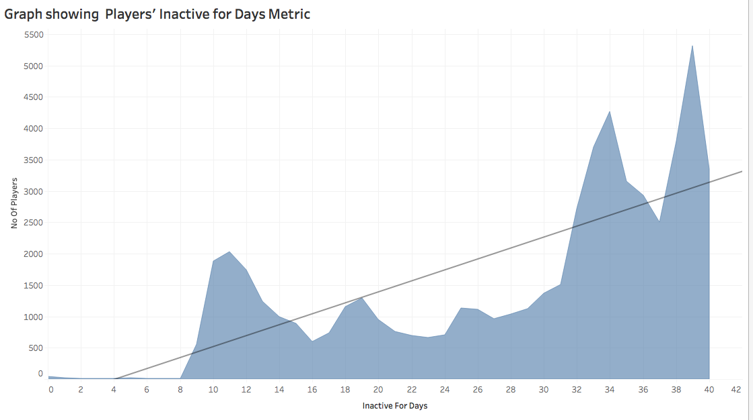

Slide 18
Large no of players are inactive for days 30-40, they don’t seem to be returning to the game anytime soon, those with 0-5 days inactive value should be targeted as they have just been inactive and any modifications to the game or exciting offers could pull them back to the game.

Slide 19
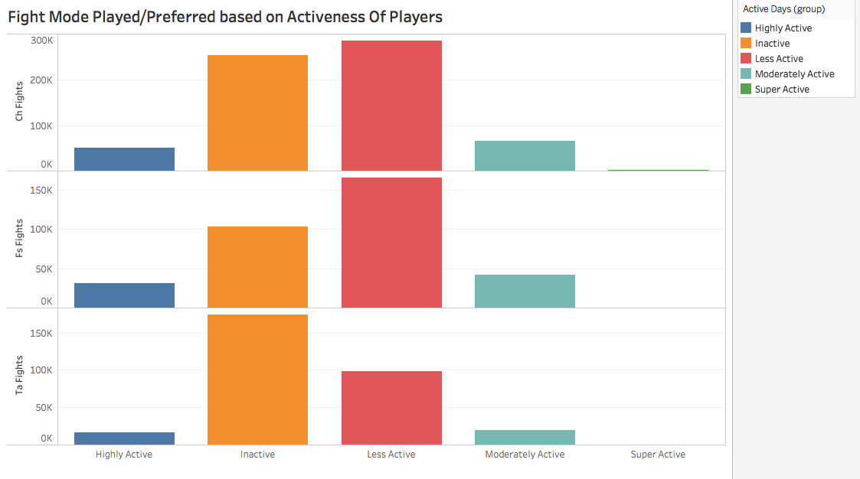

Slide 20
Highly Active players, Inactive Players, Moderately Active Players , Less Active Players and Super Active Players prefer Championship Mode,
So this mode of fight is doing the best , focus should be on maintaining it.

Slide 21
How will you begin with the data and what are the steps you will FOLLOW?
Data Analysis process would start with downloading the given Game data, exporting the data to R , store it into a data frame - game_info .
R Code-
getwd()
setwd("/Users/gurri/Downloads")
install.packages("readxl")
library(readxl)
game_info<-read_excel("PlayerInfo_Clust_withQ1.0.xlsx")
Exploratory Data Analysis/Data Exploration - The dataset has 57610 rows and 15 columns/variables .

Slide 22
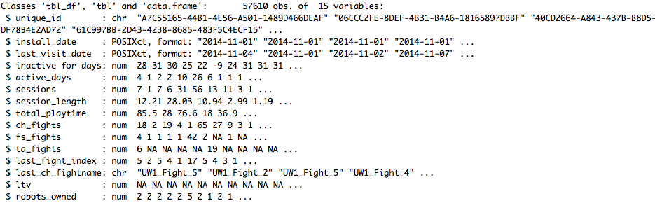
Variable Identification using str() in R – to find type, dimensions, variable names

Slide 23
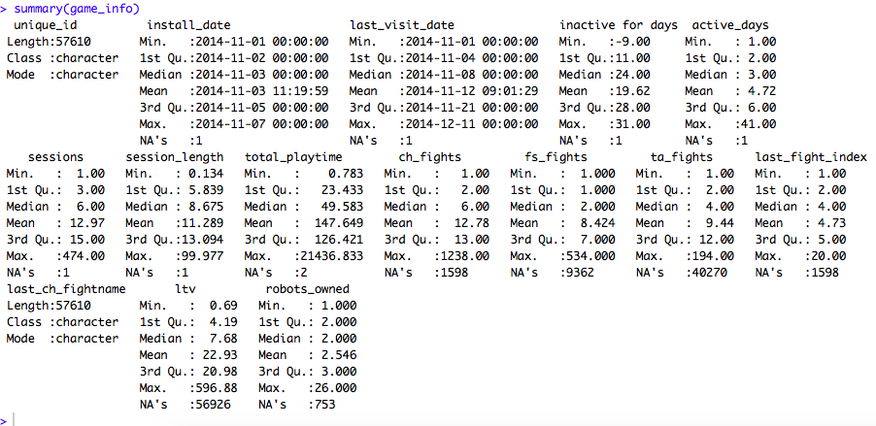
Summary of Data- variable values, mean, median, class, mode, Quartiles, min ,max values

Slide 24
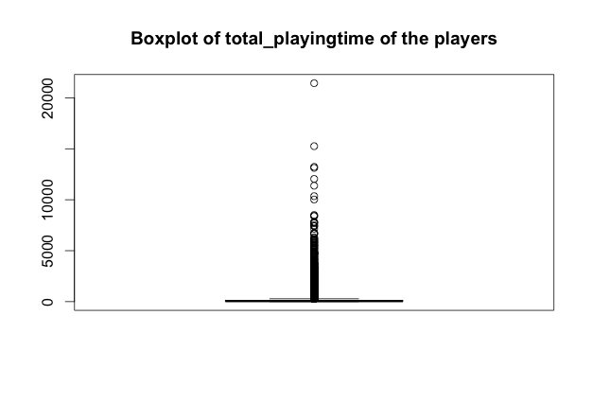
Univariate Analysis – Analyzing the variables through boxplots

Slide 25
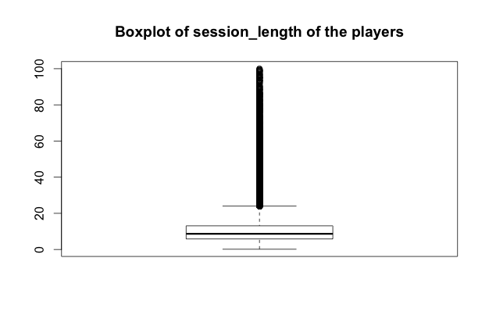

Slide 26
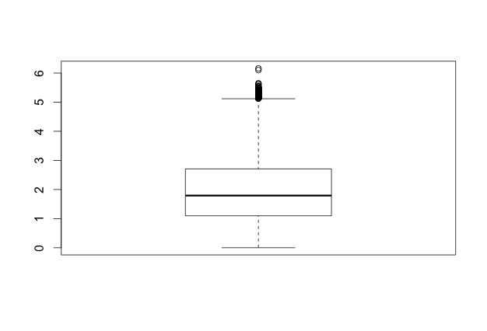
Boxplot Of log of Session Of User/Player

Slide 27
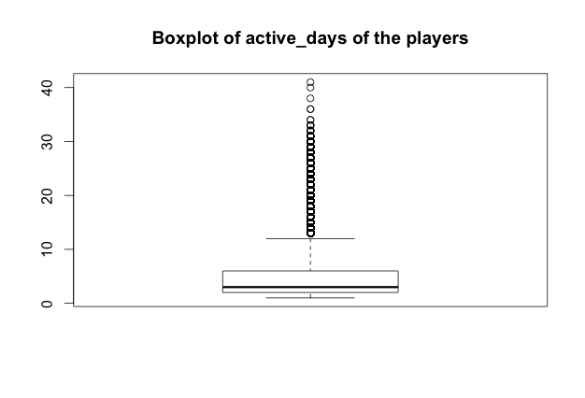

Slide 28
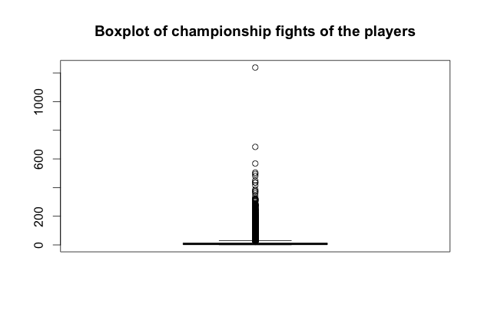

Slide 29
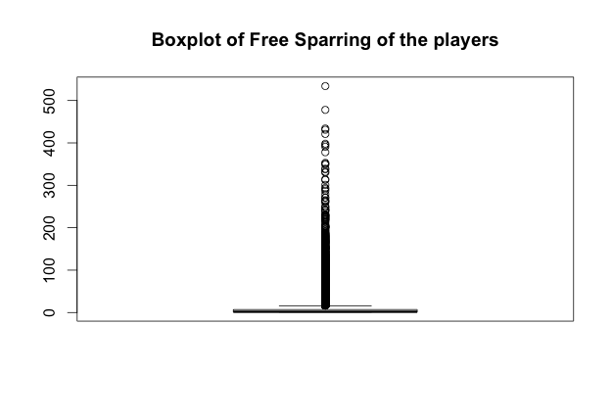

Slide 30
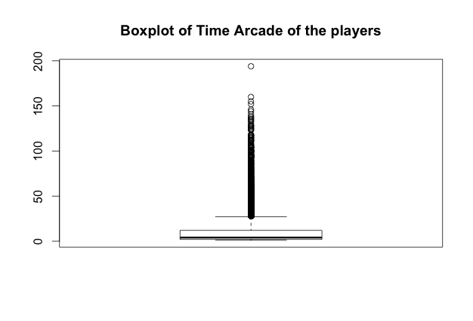

Slide 31
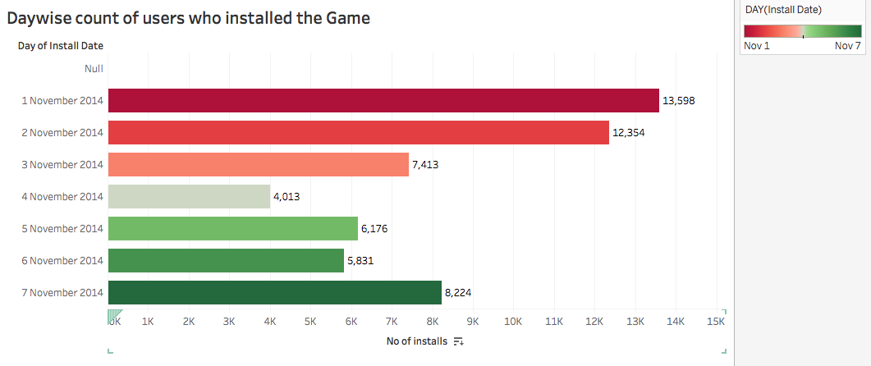
Bivariate Analysis – Analyzing the variables through Histogram/Bar chart

Slide 32
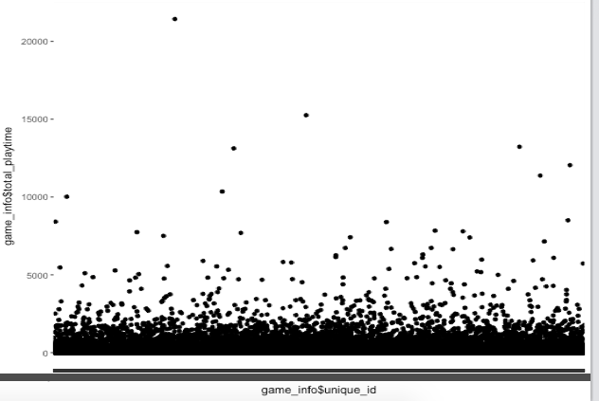
Plot Of Players vs Their Total Playtime

Slide 33
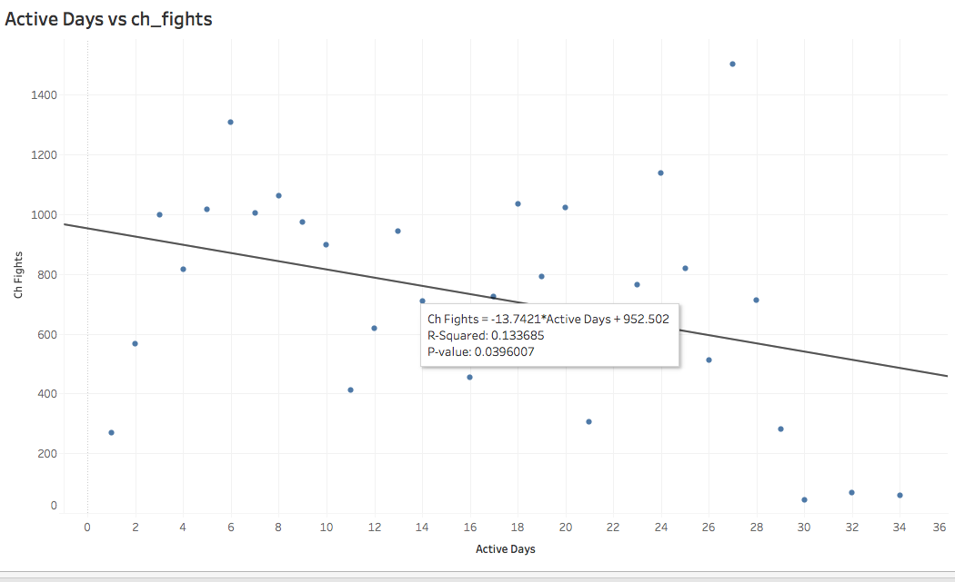

Slide 34
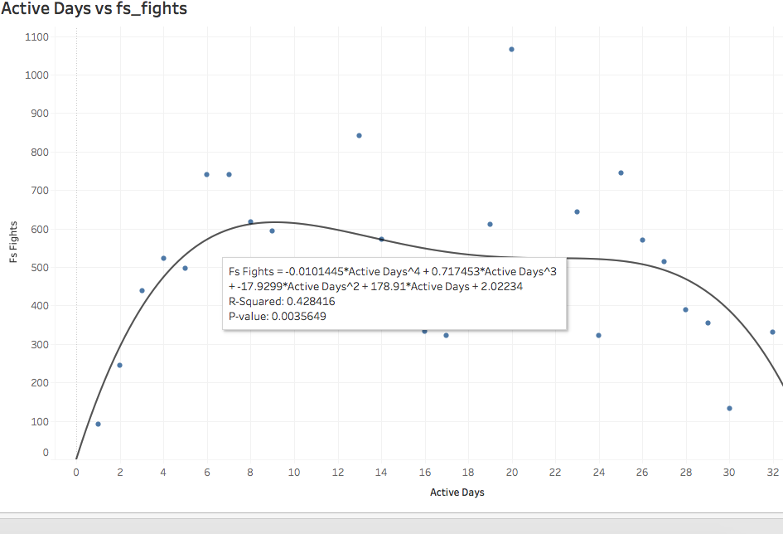

Slide 35
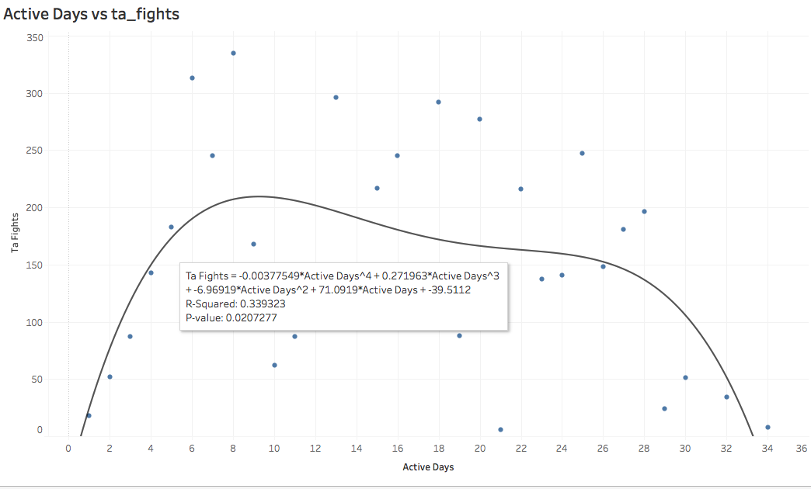

Slide 36
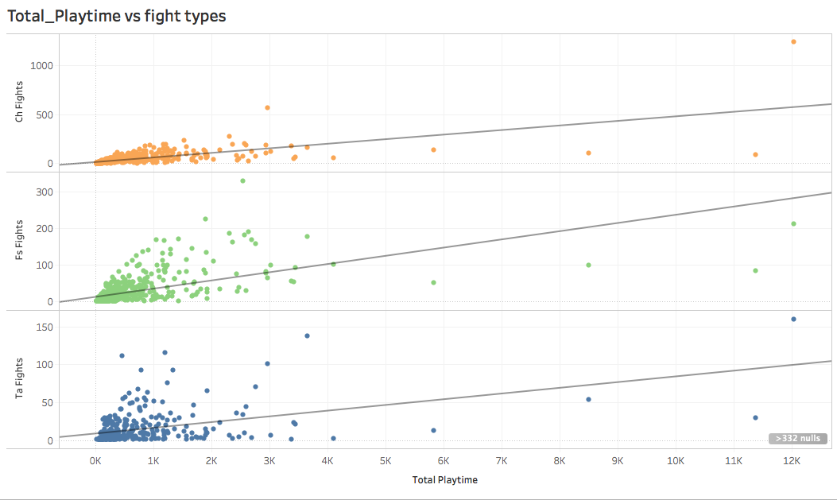

Slide 37
How would you do Data Preparation?
Data Preparation – This involves cleaning data – Identifying duplicates , Missing Values, Outliers and treating them
We can see that the columns install_date and last_visit_date when imported in R, are found to be of type character, we need to change it to Date
R Code-
game_info$install_date<-as.Date(game_info$install_date)
game_info$last_visit_date<-as.Date(game_info$last_visit_date)
In our data we don’t see any duplicates that should be deleted
summary() function gives the details about NAs in each column. We need to fill the blank values, as there are a lot of NAs in each column, we can not delete all rows containing NA values as important data would be deleted. We will use Missing Value Imputation or Predictive Model
Row number 57610 doesn’t contain any useful data and is blank for many columns, so we delete this row, now rows left =57609
On Analyzing data we find that, total_play_time value is the product of corresponding values of session and session_length ,so far blank value in total_play_time column, we simply multiply the values for corresponding rows for session and session_length

Slide 38
For ch_fights, we see that there is a strong correlation between ch_fights and variables active_days and total_play_time,we use Linear Regression model to predict the blank values of ch_fights column
R Code-
cor.test(game_info$ch_fights,game_info$total_playtime+game_info$active_days)
ch_fights_model<-lm(formula = ch_fights ~ total_playtime+active_days,
data = game_info)
na_chfights<-game_info[is.na(game_info$ch_fights),c(5,8,9)]
ch_fights_pred<-predict(ch_fights_model,newdata=na_chfights)
game_info[is.na(game_info$ch_fights),"ch_fights"]<-ch_fights_pred
We round the predicted values for ch_fights, as they can’t be in decimal,
game_info$ch_fights<-round(game_info$ch_fights)

Slide 39
Similarly is the case for fs_fights
R Code-
cor.test(game_info$fs_fights,game_info$total_playtime+game_info$active_days)
fs_fights_model<-lm(formula = fs_fights ~ total_playtime+active_days,
data = game_info)
na_fsfights<-game_info[is.na(game_info$fs_fights),c(5,8,9)]
fs_fights_pred<-predict(fs_fights_model,newdata=na_fsfights)
game_info[is.na(game_info$fs_fights),"fs_fights"]<-fs_fights_pred
game_info$fs_fights<-round(game_info$fs_fights)
game_info[which(game_info$fs_fights<0),"fs_fights"]<-0,
Rounding off the values and making all values below 0 to 0

Slide 40
For ta_fights, the correlation is moderate and not strong, so we use Imputation by Median in this case
R Code-
cor.test(game_info$ta_fights,game_info$session_length) #not strong, is moderate, impute with median
na_tafights<-game_info[is.na(game_info$ta_fights),9]
median_tafights<-median(game_info$ta_fights,na.rm=TRUE)
game_info[is.na(game_info$ta_fights),"ta_fights"]<-median_tafights

Slide 41
For last_fight_index, correlation is good betweench_fights and last_fight_index, so we use Linear Model to predict the blank values here,
R Code-
cor.test(game_info$last_fight_index,game_info$ch_fights)
last_fightindex_model<-lm(formula = last_fight_index ~ ch_fights,
data = game_info)
na_lastfightindex<-game_info[is.na(game_info$last_fight_index),c(9,12)]
last_fightindex_pred<-predict(last_fightindex_model,newdata=na_lastfightindex)
game_info[is.na(game_info$last_fight_index),"last_fight_index"]<-last_fightindex_pred
Rounding off the values, game_info$last_fight_index<-round(game_info$last_fight_index)

Slide 42
For robots_owned, correlation is very strong between robots_owned and variables ch_fights and active_days, we use Linear Model to predict the missing values in robots_owned,
R Code-
cor.test(game_info$robots_owned,game_info$ch_fights+game_info$active_days)
robots_owned_model<-lm(formula = robots_owned ~ ch_fights+active_days,
data = game_info)
na_robots_owned<-game_info[is.na(game_info$robots_owned),c(5,9)]
robots_owned_pred<-predict(robots_owned_model,newdata=na_robots_owned)
game_info[is.na(game_info$robots_owned),"robots_owned"]<-robots_owned_pred
Rounding off the predicted values, game_info$robots_owned<-round(game_info$robots_owned)

Slide 43
For inactive_for_days column we see there are negative values, On analyzing it can be seen that this column indicates the no of days a player has been inactive after his/her last visit date, the duration being considered here is upto 2 Dec, for simplicity and better data we can add 9 to all the values in the inactive_for_days column so that the considered duration now becomes 11 Dec and all the negative values are removed (they become 0 now)
R Code-
#inactive for days column has negative values, remove them by adding 9
game_info$`inactive for days`<-game_info$`inactive for days`+9

Slide 44
Outlier Treatment - During our Data Exploration we found that the boxplots show different outliers for different variables, we need to remove the outliers , generally we remove the values above the upper whisker and below the lower whisker in the boxplot.Also we can transform our variables using logarithm , sqrt, cuberoot to show the plots more efficiently
For total_play_time, the box plot is plotted using logarithm,

Slide 45
Without Log

Slide 46
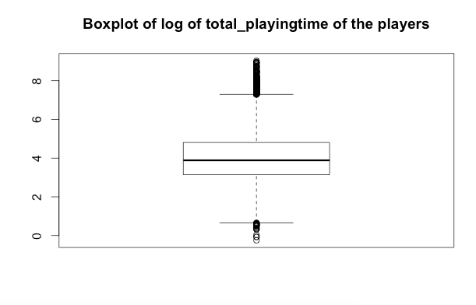
With log

Slide 47
The values above the upper whisker are above generally Q3 +1.5*IQR, for the above boxplot, these values tell us that these are the players with a large value of play time, i.e they are really active players and are the key valued customers
R Code-
up_whisker_total_playtime<-boxplot.stats(log(game_info$total_playtime))$stats[5]
outlier_totplaytime<-which(log(game_info$total_playtime)>up_whisker_total_playtime)

Slide 48
On the other hand, the values below the lower whisker tell us that these users have not spent much time playing some of the reasons could be facing technical issues, device / OS version not supported, some issue with graphics/GUI.
R Code-
lower_whisker_total_playtime<-boxplot.stats(log(game_info$total_playtime))$stats[1]
lowr_outlier_totplaytime<-which(log(game_info$total_playtime)<lower_whisker_total_playtime
For Session_Length, the plot is as follows

Slide 49
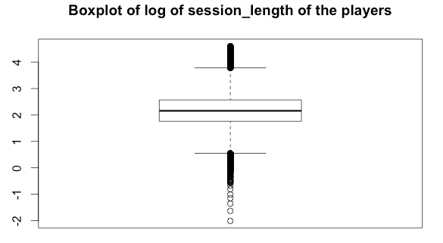
For session_length,

Slide 50
For session, we find the outliers and remove them
R Code-
up_whisker_session<-boxplot.stats(log(game_info$sessions))$stats[5]
outlier_session<-which(log(game_info$sessions)>up_whisker_session)
game_info<-game_info[-outlier_session,]

Slide 52
For active days, we see that the higher values above the upper whisker indicate the highly active users who have been active for more than 20 days during the period, these should be targeted

Slide 53
For ch_fights, the outliers are removed as:
R Code-
boxplot(log(game_info$ch_fights), main ="Boxplot of log of championship fights of the players")# remove >6
upper_whisker_ch_fights<-boxplot.stats(log(game_info$ch_fights))$stats[5]
outlier_ch_fights<-which(log(game_info$ch_fights)>upper_whisker_ch_fights)
game_info<-game_info[-outlier_ch_fights,]
For fs_fights, the outliers are removed as: both above upper whisker and below lower whisker are removed
R Code-
upper_whisker_fs_fights<-boxplot.stats(log(game_info$fs_fights))$stats[5]
lower_whisker_fs_fights<-boxplot.stats(log(game_info$fs_fights))$stats[1]
outlier_fs_fights<-which(log(game_info$fs_fights)>upper_whisker_fs_fights)
low_outlier_fs_fights<- which(log(game_info$fs_fights)<lower_whisker_fs_fights)
game_info<-game_info[-c(outlier_fs_fights,low_outlier_fs_fights),]

Slide 54
After all these operations, we are now ready with clean data, the rows remaining are 57013, so we did not lose much rows and have cleaned the data.
For our analysis we have added one more column days_retain, which tells us that the no of days a customer was retented before his last visit
R Code-
days_retained<_as.numeric(difftime(game_info$last_visit_date,game_info$install_date),units="days")
game_info[,16]<-days_retained
str(game_info)
colnames(game_info)[16]<-"days_retain"
Now, we have 16 variables in our dataset

Slide 55
What Data Modeling techniques would you use?
For Data Modelling, in our case we need to predict the missing ltv values. For this we will use Regression methods, Linear Regression and Stepwise Regression . The dependent/target variable will be ltv, and we need to analyze the different variables which would help in predicting the value of ltv..
We first split thedataset into train and test , the train dataset would be the one with ltv values present and the test dataset would be the one with the missing ltv values , to be predicted
R Code-
na_ltv<-which(is.na(game_info$ltv))
game_info_train<-game_info[-na_ltv,] #train set
game_info_test<-game_info[na_ltv,] #test set

Slide 56
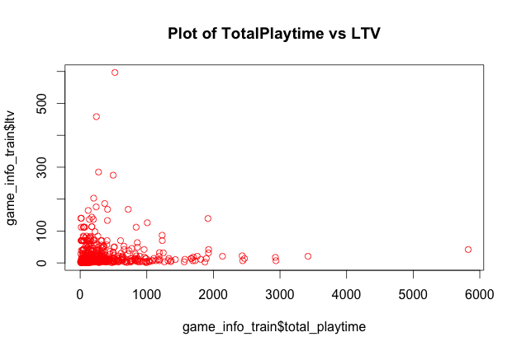
Now , plot the different variables with ltv on the train set,

Slide 57
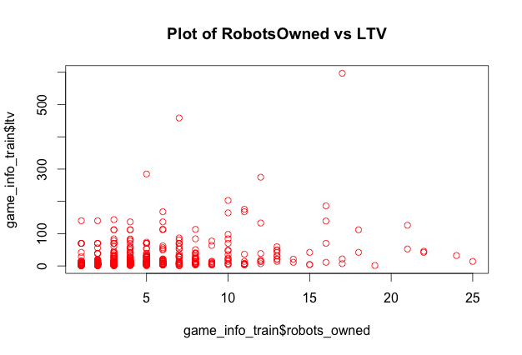

Slide 58
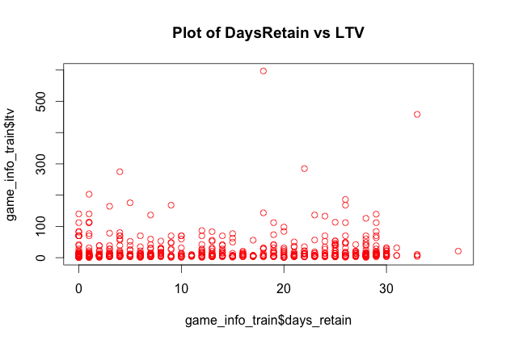

Slide 59
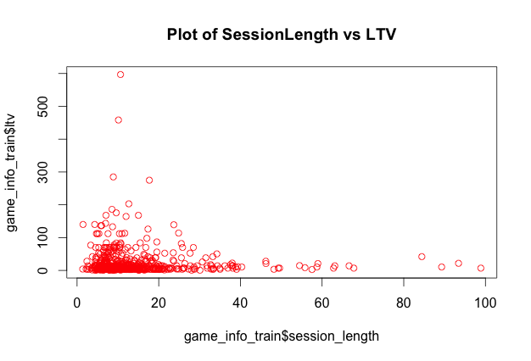

Slide 60
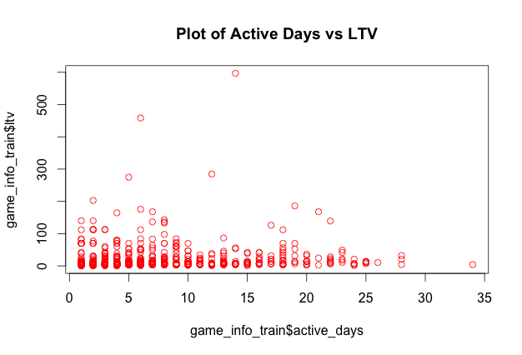

Slide 61
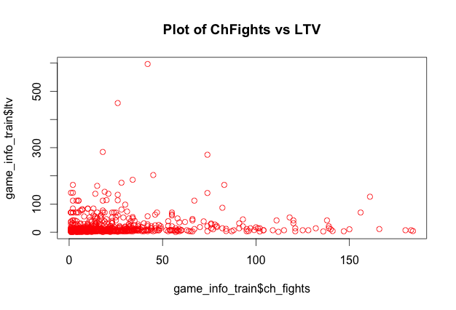

Slide 62
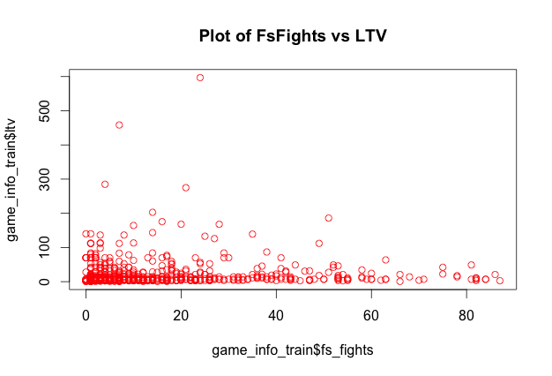

Slide 63
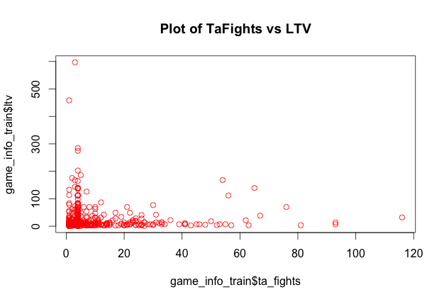

Slide 64
Linear Regression Model
R Code-
model2<-lm(data=game_info_train, ltv ~total_playtime+robots_owned+days_retain+ch_fights)
plot(model2)
summary(model2)
predicted_ltv<-predict(model2,newdata=game_info_test)
game_info_test[,"ltv"]<-predicted_ltv

Slide 65
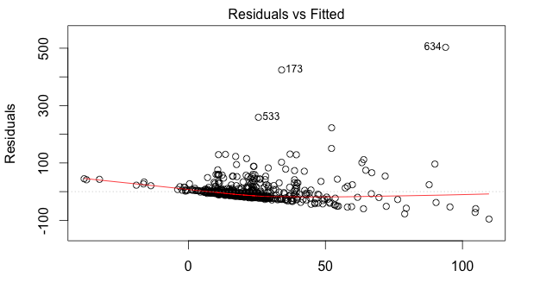

Slide 66
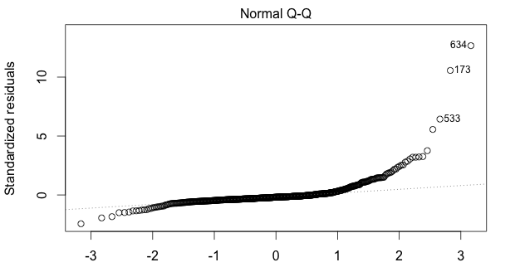

Slide 67
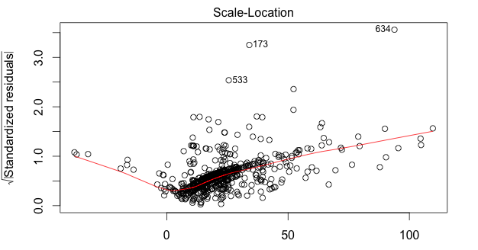

Slide 68
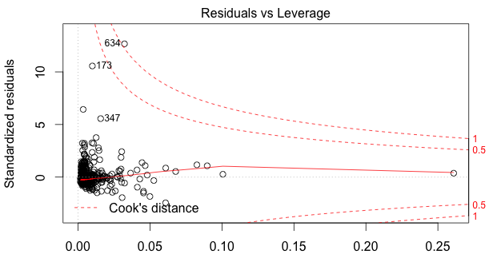

Slide 69
Stepwise Regression
R Code-
step_model<-step(lm(ltv~robots_owned+sessions+ch_fights+days_retain+total_playtime,data=game_info_train
),direction="both")
plot(step_model)
predict(step_model,newdata=game_info_test)

Slide 70
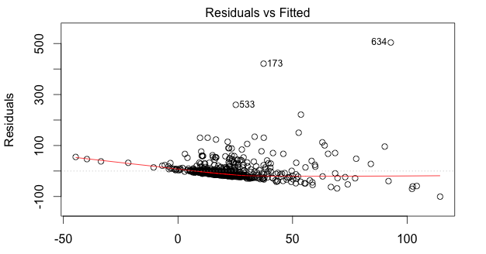

Slide 71
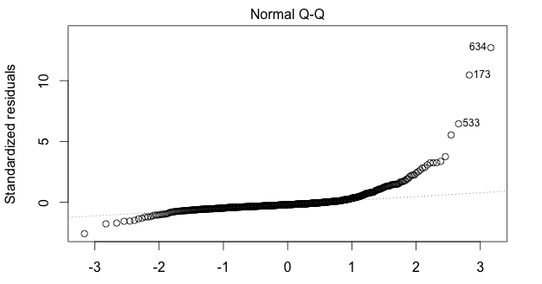

Slide 72
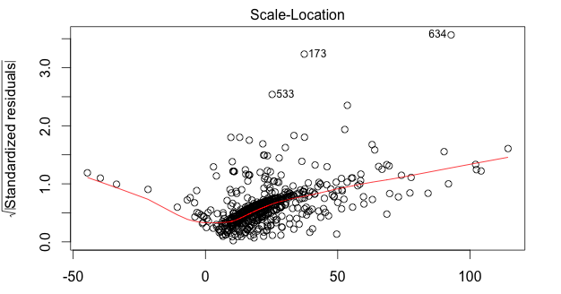

Slide 73
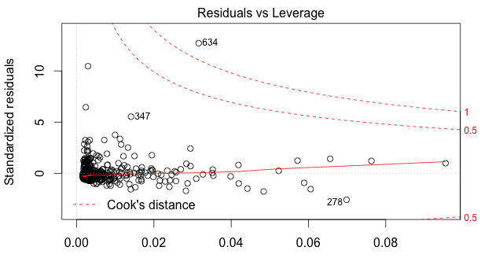

Slide 74
How would you validate your data and then your finding and eventually your recommendations?
Cross Validation – Using cross validation technique, we can find split the train set into different parts and then apply our predictive models on that, the model that gives more accurate value would be a better model and thus applied on the test dataset.
R Code-
set.seed(101)
sample<-sample.int(n = nrow(game_info_train), size = floor(.20*nrow(game_info_train)), replace = F)
game_info_train1<-game_info_train[sample,]
game_info_train2<-game_info_train[-sample,]
my_model<-lm(data=game_info_train2, ltv ~total_playtime+robots_owned+days_retain+ch_fights)
my_pred<-predict(my_model,newdata=game_info_train1)
summary(my_model)

Slide 75
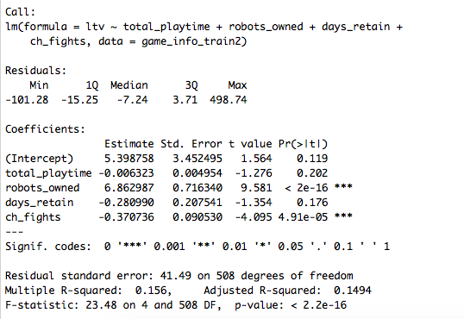

Slide 76
Using Stepwise Regression Model
R Code-
set.seed(101)
sample<-sample.int(n = nrow(game_info_train), size = floor(.20*nrow(game_info_train)), replace = F)
game_info_train1<-game_info_train[sample,]
game_info_train2<-game_info_train[-sample,]
my_model<-step(lm(ltv~robots_owned+sessions+ch_fights+days_retain+total_playtime,data=game_info_train
),direction="both")
my_pred<-predict(my_model,newdata=game_info_train1)
summary(my_model)

Slide 77
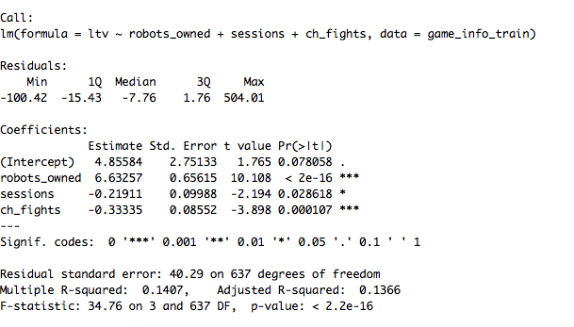

Slide 78
The results show that our Linear Model was better.
So the linear model would be used to predict the ltv of players.
Findings

Slide 79
RETENTION RATE AFTER WEEK1/2/3, ON DEC1, DEC11 IN %

Slide 80
We see that the no of players have fallen to around 49% of the total after week1 i.e 8 Nov 2014,27% after week2, around 21% after 3 weeks and stooped to a low 1.436 % after 1 Dec 2014 which means that the players don’t find the game anymore interesting, the reasons could be:
-they are stuck on a level and not able to finish
-they find it boring
- they don’t find it challenging
Strategies should be made to retain the players by engaging them in free competetions, bonus energy boosts and gold coins, to make the game more exciting.

Slide 81
RECENCY/FREQUENCY/TIME FOR PLAYERS- RFT

Slide 82
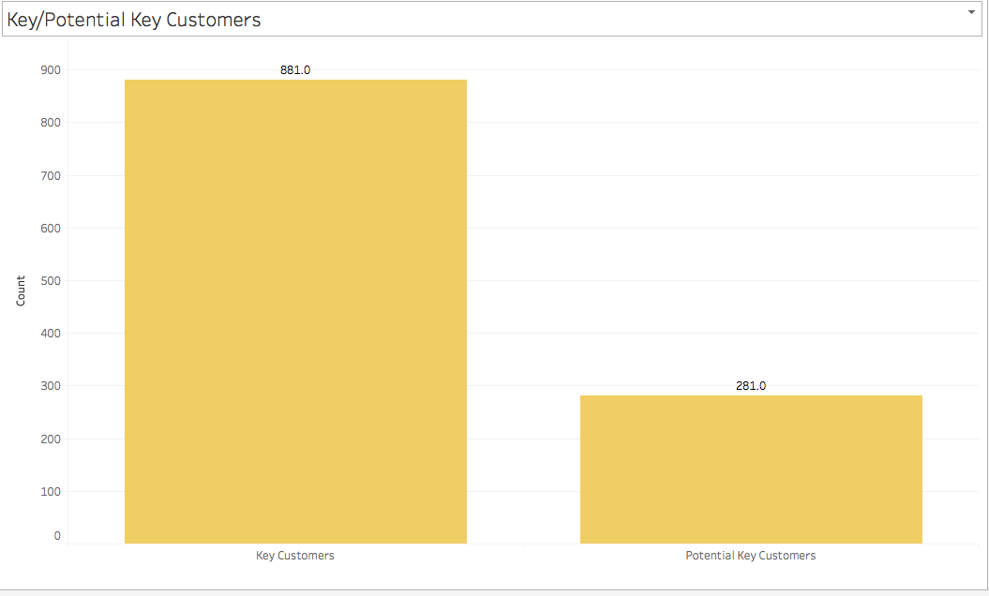
KEY/POTENTIAL KEY CUSTOMERS

Slide 83
R CODE-
#key customers
key_users<-game_info[(game_info$`inactive for days` >= 0 & game_info$`inactive for days` <=10 & game_info$sessions >= 41
& game_info$days_retain>= 25),c("unique_id","sessions")]
#potential key customers
potential_key_users<-game_info[(game_info$`inactive for days` >= 11 & game_info$`inactive for days` <=15 &
game_info$sessions >= 30 & game_info$sessions< 41
& game_info$days_retain>= 20 & game_info$days_retain< 25),"unique_id"]

Slide 84
Recommendations
RFT Analysis shows the count of players based on Recency – who played recently ,Frequency – who played frequently and Time – who spent good amount of time, these players are supposed to continue this trend and remain important players over the days. So they should be catered to special services, may be free game coins, energy boost ups,etc to engage them and see that these players are not lost.
Key and Potential Customers graph shows the no of customers who are Key customers and are deeply involved in the game – they should be the focus , the potential key customers are the ones who are just below the Key Customers and if given proper attention could be in the kEy Customers bracket.Again, special focus should be on these 2 types of customers.

Slide 85
How would you implement the Model and tools used at your end?
Implementation of the model was done using Predictive Modelling – Linear Regression Model and Stepwise Regression Model
On Cross Validation , it was found that Linear Model was better
The model implemented helped in finding the LifeTime Value of Players
Higher Lifetime value would mean more profitable customer
Tools used were R Language ,R Studio, Tableau
For capturing the data, Google Analytics could be used

Slide 86
THANK YOU

